Slide 1
Tira Beauty E-Commerce Website Automation Testing
Under Guidance of Mrs. Vaishali Sonanis
Presented By : Sohail Khan

Slide 2
Introduction
Tira Beauty is an online platform offering skincare, makeup, fragrance, and wellness products.
Goal: Test critical e-commerce functionalities (login, cart, search, category navigation, profile update).
Used Selenium WebDriver, TestNG Framework, Chrome Browser, Java

Slide 3
Members of team
Sohail Khan

Slide 4
Responsibilities
Designed & executed automated test cases.
Performed functional testing on core modules.
Created defect report for failed scenarios.

Slide 5
Overview
Application under test: www.tirabeauty.com
Type: E-Commerce Website
Testing scope:
- Login with OTP
- Search & filter products
- Add to Cart & Remove
- Shop by Category
- Change Personal Info (Profile)
- Brand-based search

Slide 6
Modules
Module 1 : Login Page Checked all login functionalities including OTP verification and profile access.
Module 2 : Search Multiple Items Verified search functionality with multiple products (Perfume, Face Wash, Shampoo, etc.).
Module 3 : Add to Cart & Remove Tested adding items to cart and removing items.

Slide 7
Modules
Module 4 : Shop by Category Ensured categories (Men, Fragrance, Skin etc.) load correctly and display products.
Module 5 : Change Personal Info Verified ability to update personal info such as Name & Date of Birth.
Module 6 : Brand Search Checked brand-wise search functionality (e.g., Davidoff Perfume).

Slide 8
Defects (From Defect Report)
While testing the Tira Beauty website, certain fields did not behave as expected. For example, the Filter Modal was not scrollable to the last option.
Expected: The user should be able to scroll and access the “Age” filter.
Actual: The user was not able to scroll : The modal froze halfway.

Slide 9
Defect identifier :- BUG-006
Defect summary :- Filter Modal not scrollable to last option
Test Id :- TC_006 Test case name :- TC_TIRA_filter_modal Module name :- Filter Reproducible :- Yes Severity :- Medium Priority :- Medium Raised by :- Sohail Khan (Tester) Assigned to :- Development Team Date of assignment :- 08-08-2025 Status :- Open Snap shots :- Fixed by :- Date of fixing :-

Slide 10
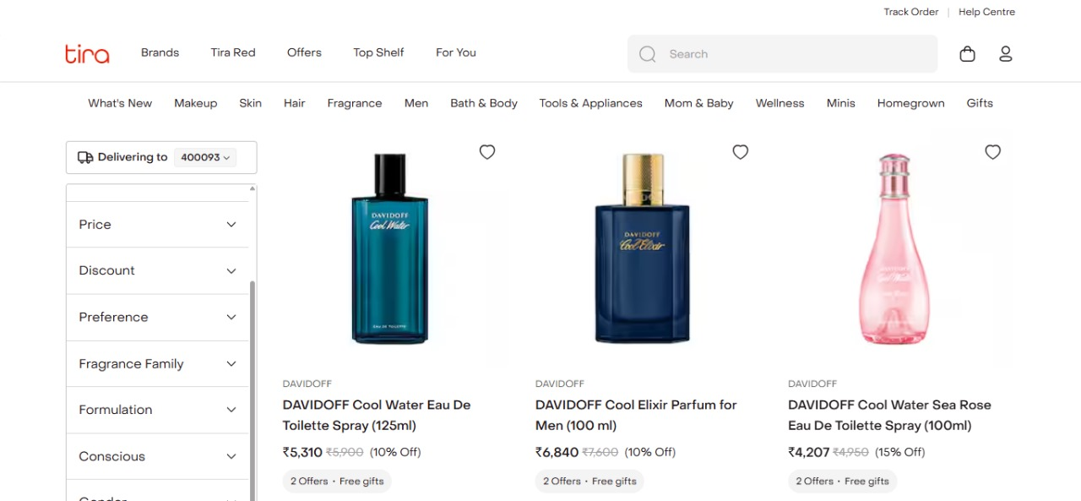
Filter Modal is Not Fully Scrollable

Slide 11
Defect identifier : BUG-010
Defect summary : No confirmation email after newsletter subscription
Test Id : TC_010 Test case name : TC_TIRA_newsletter_valid Module name : Newsletter Reproducible : Yes Severity : Medium Priority : Medium Raised by : Sohail Khan (Tester) Assigned to : Development Team Date of assignment : 08-08-2025 Status : Open Snap shots : Fixed by : – Date of fixing : –

Slide 12
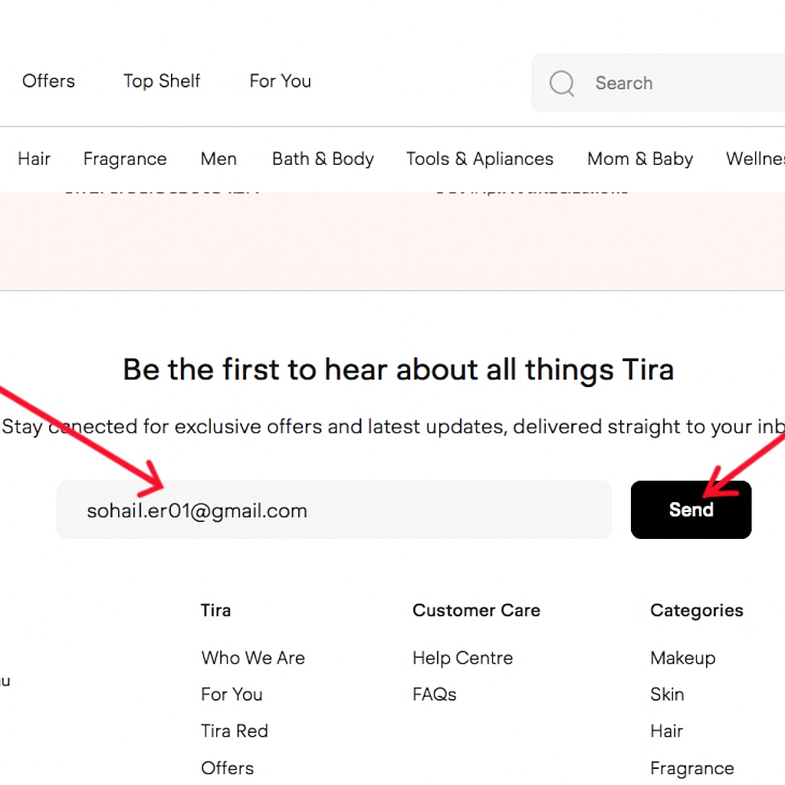
No Email is Sent to Us ( Not even in Spam Folder) for subscribing to Newsletter

Slide 13
Challenges
Dynamic elements handling required Explicit Waits.
OTP Dependent for login automation (required manual intervention).
X-path doesn’t work sometimes.

Slide 14
Experience
Learned end-to-end testing flow for an e-commerce site.
Gained hands-on experience in TestNG framework & selenium automation.
Improved debugging skills while handling XPath & waits.
Understood real-world challenges of manual + automated testing.

Slide 15
Thank You !
Vaishali Mam For Guiding Us through out the Project.

